Slide 1
Review of AI-based DNA Modification Prediction Methods and Tools
Diksha Gupta

Slide 2
Overview
Introduction
Types of DNA Modifications
Predicting Genetic Modifications in Organisms
Popular SOTA methods used in DNA Modification Prediction
Overview of 4mC: ML and DL-based prediction methods and tools
Overview of 6mA: ML and DL-based prediction methods and tools
Overview of 5hmC: ML and DL-based prediction methods and tools
Overview of 5mC: ML and DL-based prediction methods and tools
Challenges
Conclusion
References
Glossary

Slide 3
Introduction
Importance of DNA Modification Prediction
They play a vital role in regulating gene expression and cellular differentiation, and aberrations in these modifications are associated with various diseases
Aberrations in DNA modifications are associated with numerous diseases, including cancer, neurological disorders, and autoimmune diseases
Applications in medicine, biology, and forensics

Slide 4
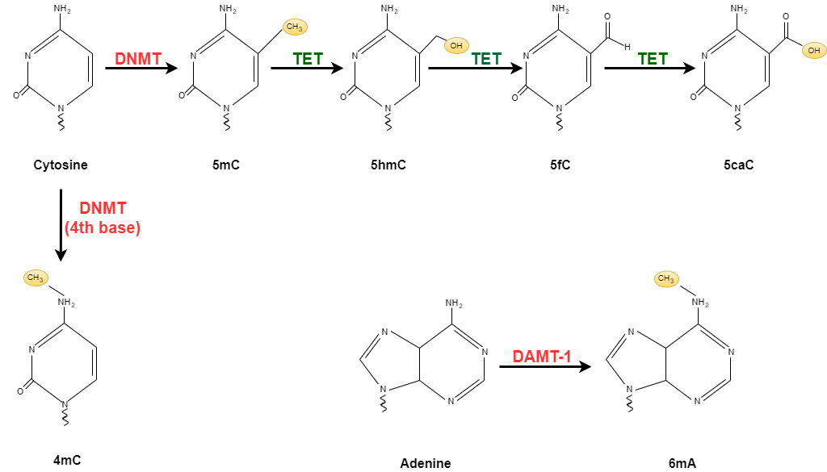
Types of DNA modifications

Slide 5
Predicting Genetic Modifications in Organisms
4mC - A. thaliana, C. elegans, D. melanogaster, E. coli, G. subterraneus, G. pickeringii
6mA - C. elegans, H. sapiens, M. musculus, Rice genome
5hmC - H. sapiens, M. musculus
5mC – From CCLE* providing information about gene promoter location

Slide 6
Popular SOTA methods used in DNA Modification Prediction
Existing methods and tools for DNA modification prediction
Traditional methods: Techniques such as single-molecule real-time sequencing (SMRT), bisulfite sequencing, etc.
Recent advances made possible by AI and machine learning: Techniques such as deep learning, convolutional neural networks, support vector machines, etc.
Why choose AI-based methods over traditional methods?

Slide 7
Comparative Analysis of ML-based Methods and Tools

Slide 8
4mC Prediction Tools and their Accuracy
Prediction Tool | Model | Accuracy | Features
iDNA4mC [1] | SVM | 80.16% | NCP*, NF*
4mCPred-SVM [2] | SVM | 82.83% | KNF*, MNBE*, DNBE*, LPDF*
4mCPred [3] | SVM | 88.5% | PSTNP*, EIIP*
4mCPred-IFL [4] | SVM | 87% | BKF*, DBPF, PCPs*, PseDNC, KNN, EIIP, MMI*, RFHC
Meta-4mCPred [5] | SVM, RF, GB, ERT | 84.33% | k- mer, BPF*, DPE*, LPDF, RFHC*, DPCP* and TPCP
SOMM4mC [6] | 2nd order markov model | 88.16% | Adjacency dependent information
Note: All six species were used as training data for these tools

Slide 9
6mA Prediction Tools and their Accuracy
Prediction Tool | Model | Accuracy | Features
MM-6mAPred [7] | 1st order markov model | 90% | Transition probability between adjacent nucleotides
iDNA6mA-Rice [8] | RF | 84% | k-tuple NFC*, MNBE, Natural vector
i6mA-Pred [9] | SVM | 83% | NCP, NF
SDM6mA | RF, XGB | 88% | NUM, MNBE, DBE LPF, RFHC, KNN* encoding
6mA-RicePred [11] | SVM | 87% | Binary encoding, NCP, K- mer and markov features
6mAPred-FO [12] | SVM | 87% | NPS*, PseDNC
Note: Rice genome was used as training data for these tools

Slide 10
5hmC Prediction Tools and their Accuracy
Prediction Tool | Model | Accuracy | Features
iDNA-MS [13] | RF | 95.5% | K-tuple nucleotide component, NPF*, and MBE*
DNA-MP [14] | RF | 96% | POCD-ND*
Note: M. musculus and H. sapiens were used as training data for these tools

Slide 11
Comparative Analysis of DL-based Methods and Tools

Slide 12
4mC Prediction Tools and their Accuracy
Prediction Tool | Model | Accuracy | Features
4mCCNN [16] | CNN | 84.66% | OHE
DeepTorrent [17] | CNN, attention and Bi-LSTM | 86% | OHE, CKSNAP*, NCP, EIIP, ENAC*, ANF*, PSTNPs*
i4mCDeep [18] | CNN | 90.66% | NCP, ND*
DCNN-4mC [15] | CNN | 94.16% | OHE, DNBE, TNBE*, PNF*, k- mer
Note: All six species were used as training data for these tools

Slide 13
6mA Prediction Tools and their Accuracy
Prediction Tool | Model | Accuracy | Features
6mA-Pred [19] | LSTM | 95.5% | Kmer word segmentation
iDNA-MT [20] | BGRU | 96% | 2-gram OHE*
Note: M. musculus, rice and H. sapiens were used as training data for 6mA-Pred where as H. sapiens and D. melanogaster were used as training for iDNA-MT

Slide 14
5mC Prediction Tools and their Accuracy
Prediction Tool | Model | Accuracy | Features
iPromoter-5mC [21] | DNN | 90% | OHE, DPF (Deoxynucleotide Property and Frequency)
BiLSTM-5mC [22] | BiLSTM | 93% | OHE, NCP, NF

Slide 15
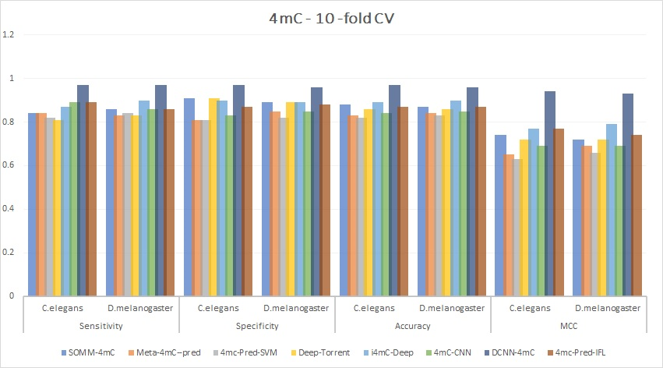
Overview of 4mC: ML and DL-based prediction methods and tools

Slide 16
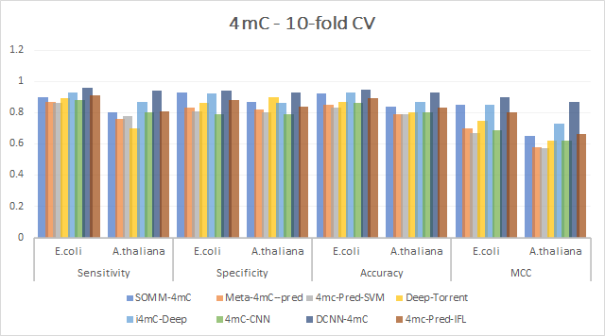

Slide 17
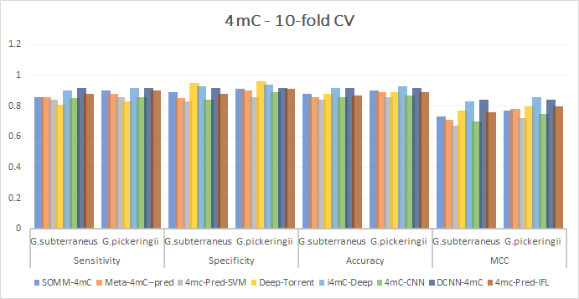

Slide 18
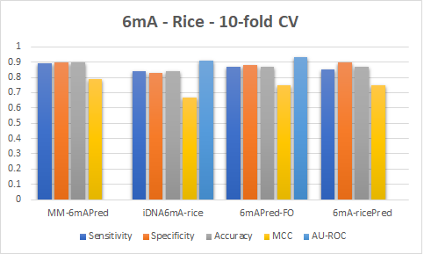
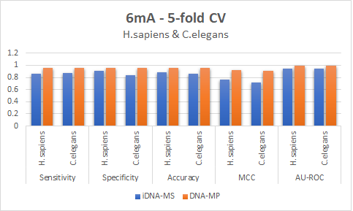
Overview of 6mA: ML and DL-based prediction methods and tools

Slide 19
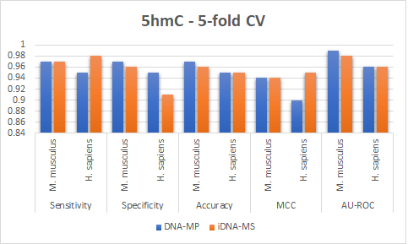
Overview of 5hmC: ML and DL-based prediction methods and tools

Slide 20
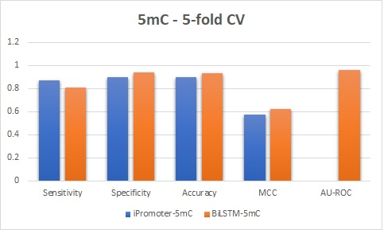
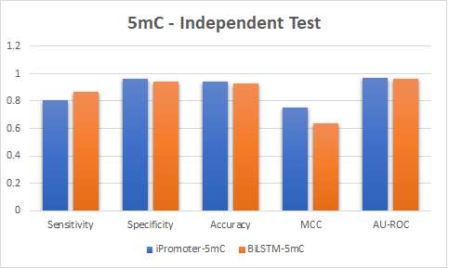
Overview of 5mC: ML and DL-based prediction methods and tools

Slide 21
Challenges
Improving the accuracy and interpretability of AI-based methods is crucial to make these models more applicable in the clinical setting
Expanding the use of epigenetic data can improve the accuracy of DNA modification prediction
Addressing ethical and legal concerns including issues related to privacy and data ownership
Collaboration among researchers, clinicians, and policymakers

Slide 22
Conclusion
DNA modification prediction is promising for personalized medicine
AI-based methods need improvement in accuracy and interpretability
Epigenetic data improves prediction accuracy
Collaboration needed to address ethical and legal concerns
Continued research has the potential for new treatments and cures

Slide 23
References
Chen, W., Yang, H., Feng, P., Ding, H. and Lin, H., 2017. iDNA4mC: identifying DNA N4-methylcytosine sites based on nucleotide chemical properties. Bioinformatics, 33(22), pp.3518-3523. [1]
Wei, L., Luan, S., Nagai, L.A.E., Su, R. and Zou, Q., 2019. Exploring sequence-based features for the improved prediction of DNA N4-methylcytosine sites in multiple species. Bioinformatics, 35(8), pp.1326-1333. [2]
He, W., Jia, C. and Zou, Q., 2019. 4mCPred: machine learning methods for DNA N4-methylcytosine sites prediction. Bioinformatics, 35(4), pp.593-601. [3]
Wei, L., Su, R., Luan, S., Liao, Z., Manavalan, B., Zou, Q. and Shi, X., 2019. Iterative feature representations improve N4-methylcytosine site prediction. Bioinformatics, 35(23), pp.4930-4937. [4]
Manavalan, B., Basith, S., Shin, T.H., Wei, L. and Lee, G., 2019. Meta-4mCpred: a sequence-based meta-predictor for accurate DNA 4mC site prediction using effective feature representation. Molecular Therapy-Nucleic Acids, 16, pp.733-744. [5]
Yang, J., Lang, K., Zhang, G., Fan, X., Chen, Y. and Pian, C., 2020. SOMM4mC: a second-order Markov model for DNA N4-methylcytosine site prediction in six species. Bioinformatics, 36(14), pp.4103-4105. [6]
Pian, C., Zhang, G., Li, F. and Fan, X., 2020. MM-6mAPred: identifying DNA N6-methyladenine sites based on Markov model. Bioinformatics, 36(2), pp.388-392. [7]
Lv, H., Dao, F.Y., Guan, Z.X., Zhang, D., Tan, J.X., Zhang, Y., Chen, W. and Lin, H., 2019. iDNA6mA-Rice: a computational tool for detecting N6-methyladenine sites in rice. Frontiers in genetics, 10, p.793. [8]
Chen, W., Lv, H., Nie, F. and Lin, H., 2019. i6mA-Pred: identifying DNA N6-methyladenine sites in the rice genome. Bioinformatics, 35(16), pp.2796-2800. [9]

Slide 24
References
Huang, Q., Zhang, J., Wei, L., Guo, F. and Zou, Q., 2020. 6mA-RicePred: a method for identifying DNA N 6-methyladenine sites in the rice genome based on feature fusion. Frontiers in plant science, 11, p.4. [11]
Cai, J., Wang, D., Chen, R., Niu, Y., Ye, X., Su, R., Xiao, G. and Wei, L., 2020. A bioinformatics tool for the prediction of DNA N6-Methyladenine modifications based on feature fusion and optimization protocol. Frontiers in Bioengineering and Biotechnology, 8, p.502. [12]
Lv, H., Dao, F.Y., Zhang, D., Guan, Z.X., Yang, H., Su, W., Liu, M.L., Ding, H., Chen, W. and Lin, H., 2020. iDNA-MS: an integrated computational tool for detecting DNA modification sites in multiple genomes. Iscience, 23(4), p.100991. [13]
Nabeel Asim, M., Ali Ibrahim, M., Fazeel, A., Dengel, A. and Ahmed, S., 2023. DNA-MP: a generalized DNA modifications predictor for multiple species based on powerful sequence encoding method. Briefings in Bioinformatics, 24(1), p.bbac546. [14]
Rehman, M.U., Tayara, H. and Chong, K.T., 2021. DCNN-4mC: Densely connected neural network based N4-methylcytosine site prediction in multiple species. Computational and structural biotechnology journal, 19, pp.6009-6019. [15]
Khanal, J., Nazari, I., Tayara, H. and Chong, K.T., 2019. 4mCCNN: Identification of N4-methylcytosine sites in prokaryotes using convolutional neural network. Ieee Access, 7, pp.145455-145461. [16]
Liu, Q., Chen, J., Wang, Y., Li, S., Jia, C., Song, J. and Li, F., 2021. DeepTorrent: a deep learning-based approach for predicting DNA N4-methylcytosine sites. Briefings in bioinformatics, 22(3), p.bbaa124. [17]
Alam, W., Tayara, H. and Chong, K.T., 2021. i4mc-deep: an intelligent predictor of n4-methylcytosine sites using a deep learning approach with chemical properties. Genes, 12(8), p.1117. [18]
Huang, Q., Zhou, W., Guo, F., Xu, L. and Zhang, L., 2021. 6mA-Pred: identifying DNA N6-methyladenine sites based on deep learning. PeerJ, 9, p.e10813. [19]
Yang, X., Ye, X., Li, X. and Wei, L., 2021. Idna-mt: identification DNA modification sites in multiple species by using multi-task learning based a neural network tool. Frontiers in Genetics, 12, p.663572. [20]

Slide 25
References
Zhang, L., Xiao, X. and Xu, Z.C., 2020. iPromoter-5mC: a novel fusion decision predictor for the identification of 5-methylcytosine sites in genome-wide DNA promoters. Frontiers in Cell and Developmental Biology, 8, p.614. [21]
Cheng, X., Wang, J., Li, Q. and Liu, T., 2021. BiLSTM-5mC: a bidirectional long short-term memory-based approach for predicting 5-methylcytosine sites in genome-wide DNA promoters. Molecules, 26(24), p.7414. [22]

Slide 26
Glossary
NCP - Nucleosome Core Particle
NF - Nucleotide Frequency
KNF - k- mer-based Nucleotide Frequency
MNBE - Minimal Non-zero Bivalent Encoding
DNBE - Di-nucleotide Binary Encoding
LPDF - Local Positional Dinucleotide Frequency
PSTNP - Position-Specific Triplet Nucleotide Frequency
EIIP - Electron-Ion Interaction Potential
BPF - Binary Positional Frequency
DPE - Dinucleotide-based Positional Encoding
RFHC - Random Forest with Hybrid Classification
DPCP - Dinucleotide-based Positional Classification Probability
BKF – Binary Kernel Function
PCP – Positional Correlation Potential
NFC - Nucleotide Chemical Features
NUM - Nucleotide physicochemical properties Using the Mean
DBE LPF - Dinucleotide Binary Encoding Local Positioning Features
KNN - k-Nearest Neighbors
NPS - Nucleotide Position Specificity
PseDNC - Pseudo Dinucleotide Composition
POCD-ND - Position and Orientation-Dependent Dinucleotide
CKSNAP - Composition k-Spectrum Normalization and Position weight matrix.
ENAC - Extended Nucleotide Alphabet Classifier
ANF - Alphabet Nucleotide Frequency
ND - Nucleotide Distribution
OHE - One Hot Encoding
PNF - Positional dinucleotide frequency
MMI – Molecular Mechanics Interaction
TNBE - Triplet-based Nucleotide Binary Encoding

